Slide 1
Topic 5: Bonding 5.4: Covalent Bonding
AIM:

Slide 2
Do Now
Draw the Lewis dot structure for magnesium
Draw the Lewis dot structure for a magnesium ion
Draw the Lewis Dot structure for MgO

Slide 3
Aim
What are covalent bonds?

Slide 4
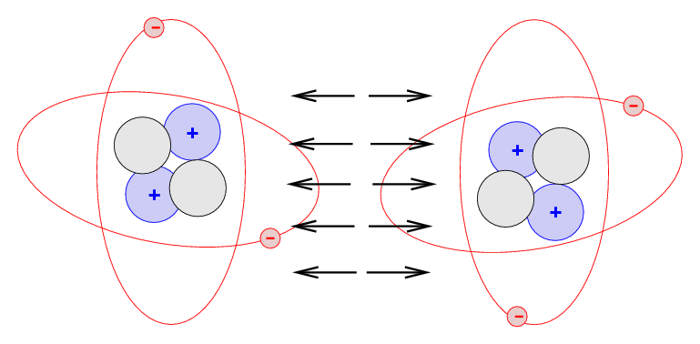
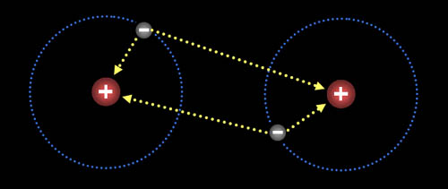
Bonds
As atoms come
close to each other
Electrons from
both atoms repel
Positive nuclei repel
Positively charged
nucleus of one atom
is attracted to the
negative electrons of
the other atom

Slide 5
Bonds
Chemical bond occur when the attractive forces between atoms are greater than the repulsive forces
What attracts them is stronger than what is pushing them apart

Slide 6
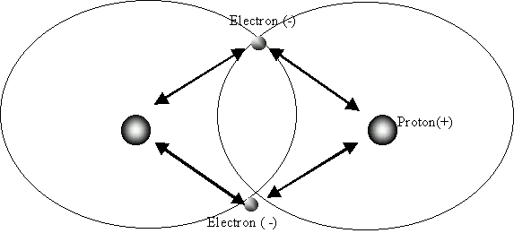
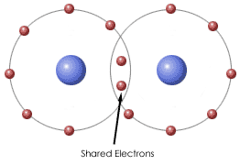
Covalent Bonds
When two nuclei share electrons in order to achieve a stable arrangement of electrons
Each bond has two electrons being shared

Slide 7
Covalent Bonds
Electronegativity difference is less than 1.7
Often form between 2 nonmetals
Cl₂ SO₂

Slide 8
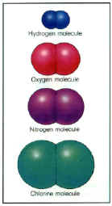
Diatomic Elements
Atoms of the same element share
electrons to have stable electron
configurations
Diatomic = 2 atoms
BrINClHOF
Br₂ I₂ N₂ Cl₂ H₂ O₂ F₂

Slide 9
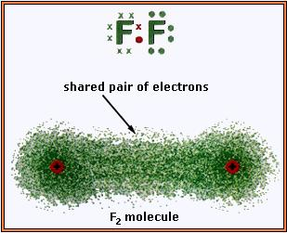
Nonpolar Covalent Bond
Formed between atoms have equal or close electronegativity values = two nonmetals
Difference < 0.4
The attraction for the shared electrons is equal, causing the pair of electrons to be shared equally
Usually diatomic molecules
N₂ Cl₂

Slide 10
Polar Covalent Bonds
Most atoms have different electronegativities
Attraction of electrons is different in both atoms = sharing of electrons is unequal
H₂O CO₂

Slide 11
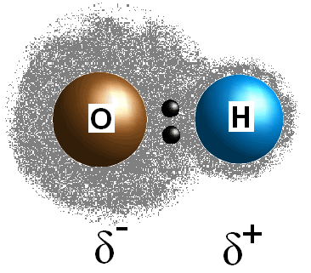
Polar Covalent Bonds
Unequal sharing of electrons in a covalent bond
Between two nonmetals
Electronegativity difference between 0.4 and 1.7
The element with the higher
EN attracts the shared
electrons more strongly,
causing that atom to become
slightly negative

Slide 12
Polar Covalent Bond
HCl HI

Slide 13
Electron Distribution
Ionic
Polar Covalent
Nonpolar Covalent

Slide 14
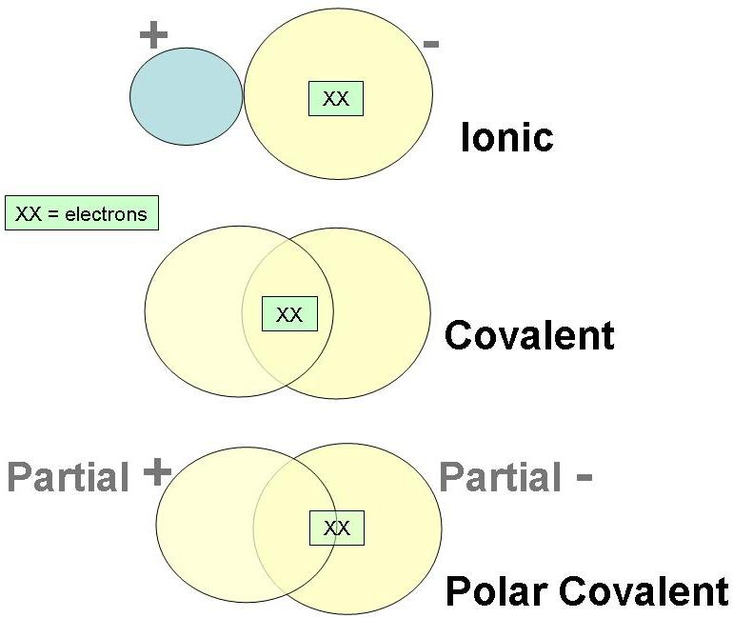
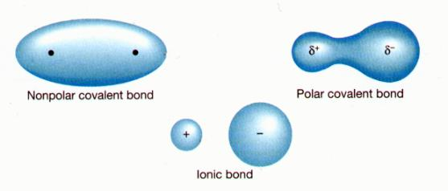
Electron Distribution

Slide 15
Multiple Covalent Bond
Atoms may share more than one pair of electrons = multiple covalent bonds
Single bond = 2 electrons
Double bond = 4 electrons
Triple bond = 6 electrons

Slide 16
Multiple Covalent Bonds
Double Bond
Triple Bond
Sharing 4 electrons
O₂
Sharing 6 electrons
N₂

Slide 17
Polyatomic Ions
(NH₄)₂CO₃
Contain ionic and covalent bonds
Ionic bond = ammonium ion attracted to carbonate ion
Covalent bond = atoms within the polyatomic ions = CO₃

Slide 18
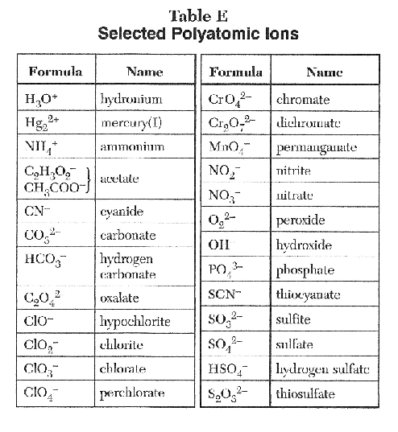

Slide 19
Regents Question
A covalent bond forms when
Two nuclei share electrons in order to achieve a complete octet of electrons
Atoms form ions and then electrostatic forces of attraction bond the ions together
Repulsive forces between atoms are greater than the attractive forces
A metal atom combines with a nonmetal atom

Slide 20
Regents Question
Which of the following bonds is the most polar in nature?
Cl₂
HCl
HBr
HI

Slide 21
Regents Question
Polar covalent bonds are caused by
Unbalanced ionic charges
Unequal electronegativity values
The transfer of electrons from one atom to another
Equally sharing valence electrons

Slide 22
Regents Question
The bond in a diatomic nitrogen molecule (N₂) is best describes as
Polar
Polar double covalent
Nonpolar triple covalent
Polar ionic

Slide 23
Do Now
How do you determine how polar a bond is?
What happens to electrons in a nonpolar covalent bond?

Slide 24
Aim
How do we show covalent bonding using Lewis Dot diagrams??

Slide 25
Lewis Dot Diagrams – Covalent Compounds
Shows how atoms combine to form molecules
Lewis Structure for a hydrogen atom
Two hydrogen atoms combine = H₂ molecule
Instead of using dots to show the shared pair of electrons = a single dash can be used to show the covalent bond

Slide 26
Lewis Dot Diagrams – Covalent Compounds
Cl₂
O₂
N₂
HCl

Slide 27
Lewis Dot Diagrams – Covalent Compounds
The octet rule = all atoms should have 8 valence electrons
Hydrogen = exception = 2 valence electrons

Slide 28
Lewis Dot Diagrams – Covalent Compounds
Follow these steps:
1. determine the total number of valence electrons of the atoms
CH₃Cl

Slide 29
Lewis Dot Diagrams – Covalent Compounds
2. arrange the atoms to show bonds between them = central atom has the lowest EN
add dashes between the atoms to represent shared pair of electrons
distribute the remaining electrons

Slide 30
Lewis Dot Diagrams – Covalent Compounds
3. make sure that each atoms has an octet

Slide 31
Lewis Dot Diagrams – Covalent Compounds
CCl₄
CX₄

Slide 32
Lewis Dot Diagrams – Covalent Compounds
H₂O

Slide 33
Lewis Dot Diagrams – Covalent Compounds
CO₂

Slide 34
Lewis Dot Diagrams – Covalent Compounds
NH₃

Slide 35
Lewis Dot Diagrams – Covalent Compounds
C₂H₂

Slide 36
Regents Question
What is the correct electron dot diagram for hydrogen chloride?
..
H:Cl (3) H:Cl:
.. ..
(2) : H : Cl (4) :H:Cl:
.. ..

Slide 37
Regents Question
Which electron dot formula represents a substance that contains a nonpolar covalent bond?
.. ..
[Na]⁺ [:Cl:]⁻ (3) H:Cl:
.. .. .. .. ..
(2):Cl:Cl: (4) :O:H
.. .. ..
H

Slide 38
Regents Question
Which electron dot diagram represents a molecule that has a polar covalent bond?
.. .. ..
(1) H:Cl: (3) :Cl:Cl:
.. .. ..
.. ..
(2) Li⁺ [:Cl:]⁻ (4) K⁺ [:Cl:]⁻
.. ..

